Slide 1
Data Science: What it isn’t? (And what is AI?)
Xiao-Li Meng
Department of Statistics, Harvard University
Thanks to many colleagues and students, especially the teams at HDSI and HDSR, and various internet sources.

Slide 2

It all started from …

Slide 3
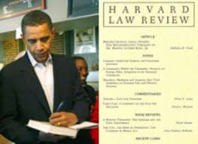
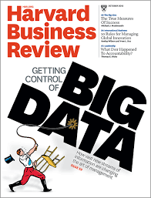
HDSR
The Digital Platform for Scholarship, Learning, and Impact of Data Science
A Premier Research Journal
A Popular Magazine
A Leading Education Publication

Slide 4
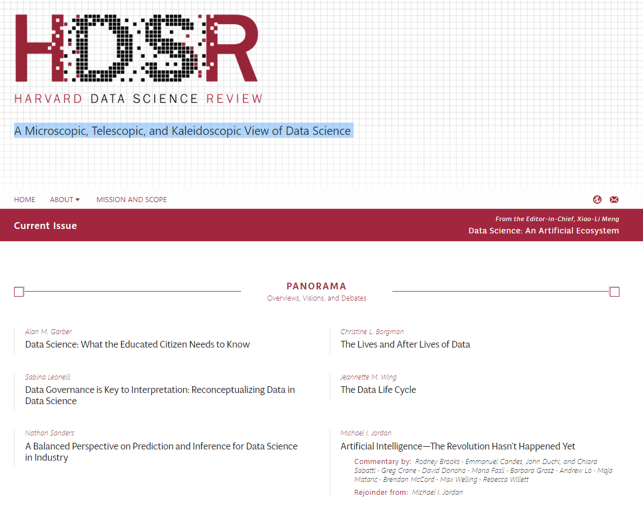

Slide 5
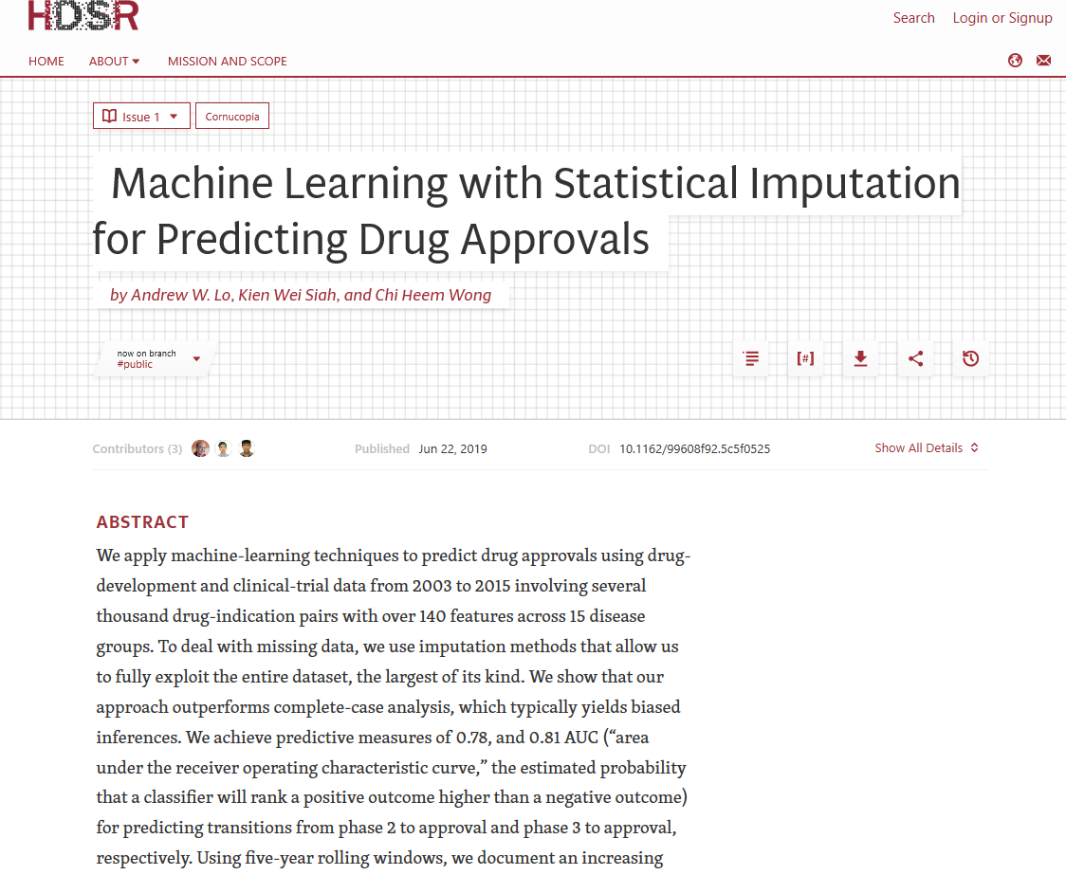

DS is not just machine learning or just statistics.

Slide 6
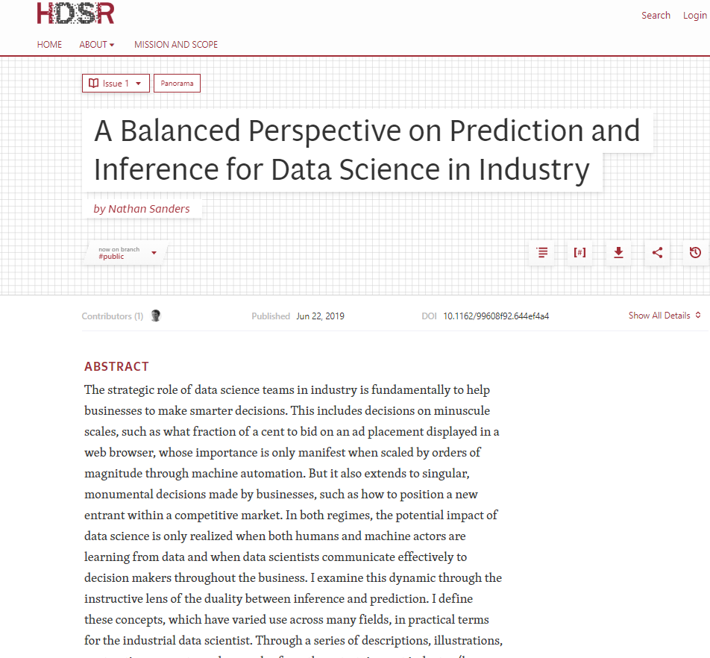

2. DS is not all about prediction.

Slide 7
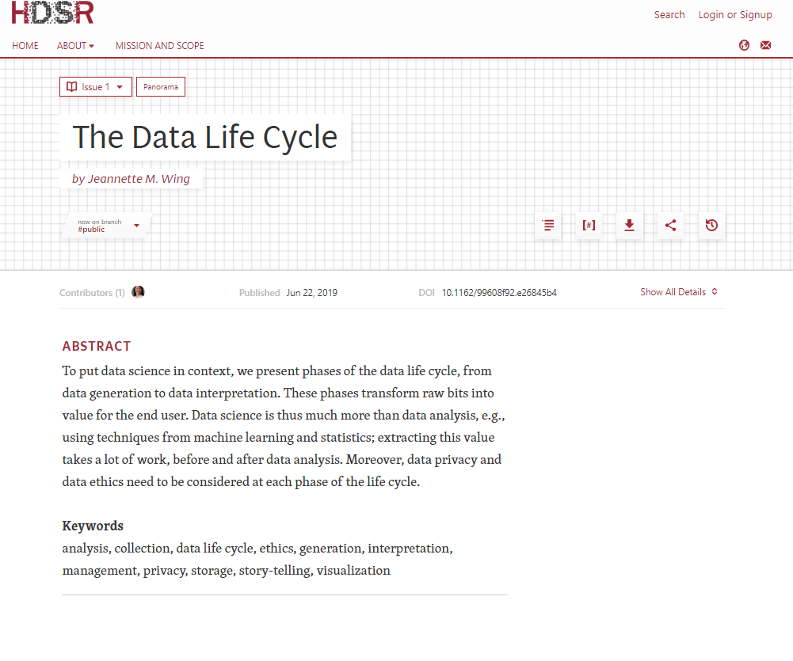
3. DS is not only about data analysis.

Slide 8

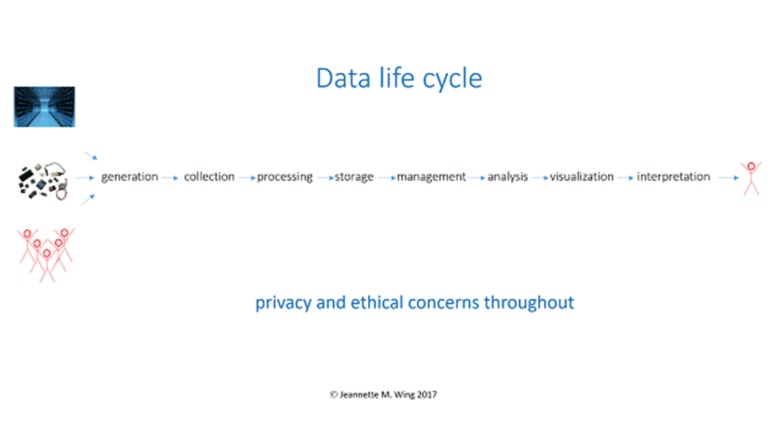
The Data Life Cycle
Jeannette M. Wing
Department of Computer Science
Columbia University
Data science is the study of extracting value from data. “Value” is subject to the interpretation by the end user and “extracting” represents the work done in all phases of the data life cycle (see figure below).

Slide 9
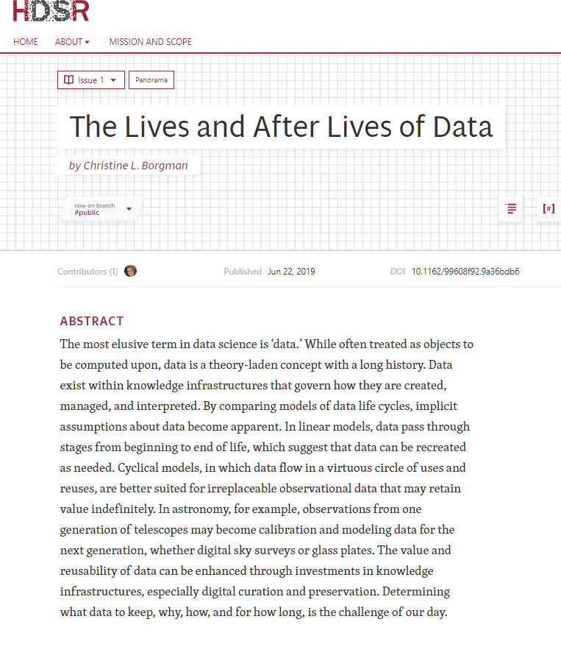
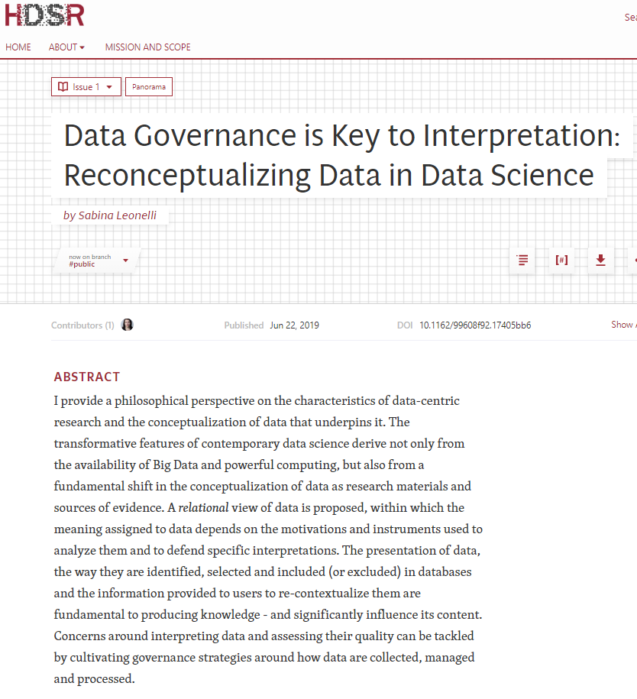
4. DS is not a discipline that sits merely within STEM field.

Slide 10
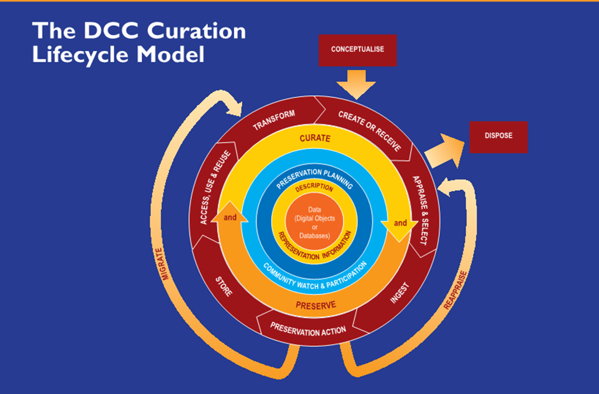
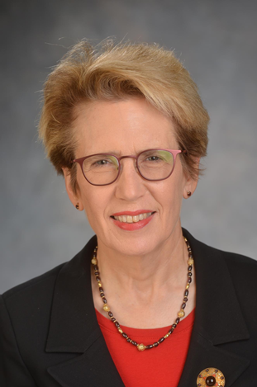
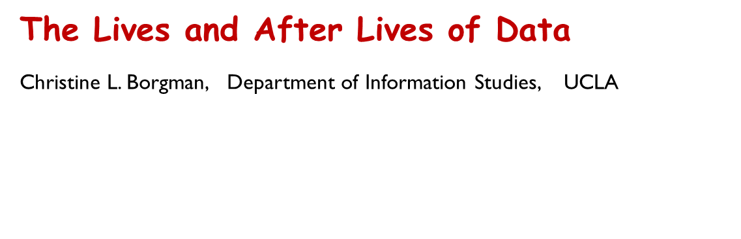

Slide 11
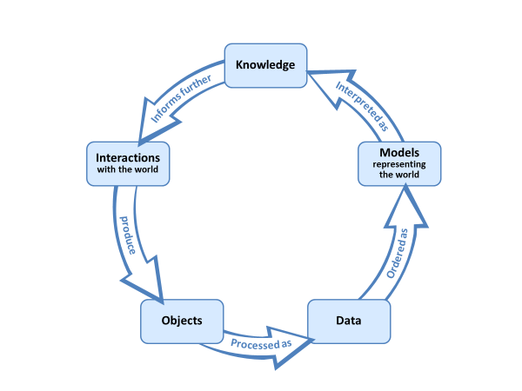

Data governance is key to interpretation: Reconceptualizing data in data science
Sabina Leonelli
Department of Sociology, Philosophy and Anthropology
& Exeter Centre for the Study of the Life Sciences (Egenis), University of Exeter, UK

Slide 12
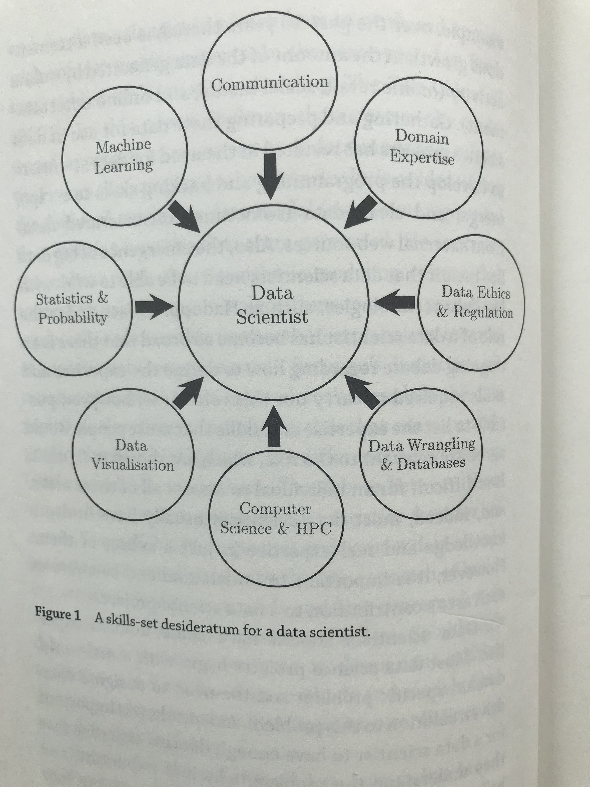
So what should be a data scientist’s skill set?
Diagram from “Data Science” by John D. Kelleher, Brendan Tierney

Slide 13
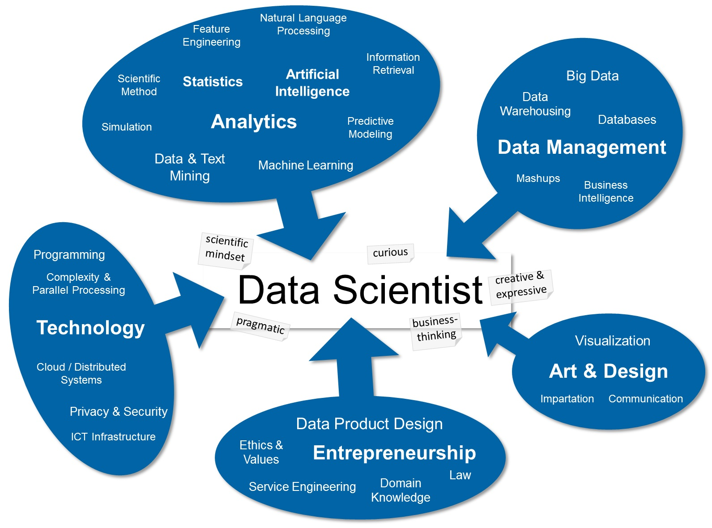
https://stdm.github.io/images/skillset.jpg

Slide 14
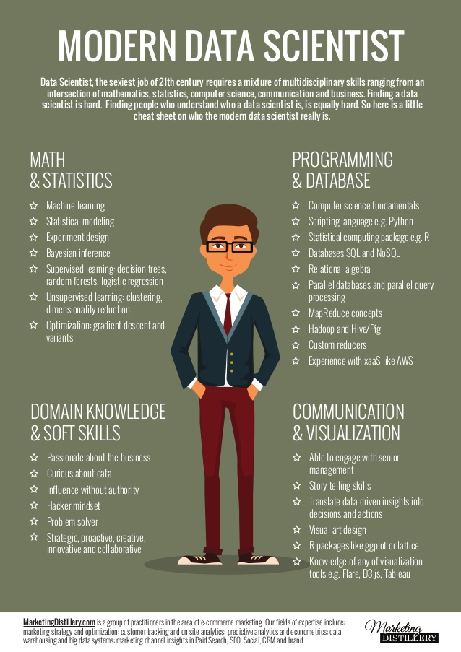

Let’s not make data science a tiger mom
https://www.slideshare.net/WhiteRavenPL/mds-38529815

Slide 15
5. Most critically, DS is not even a single discipline by itself. And hence it should not be squeezed into a “Department of Data Science”
There are science and scientists,
but few “Department of Science”
There are social science and social scientists,
but few “Department of Social Science”
There are humanities and humanists,
but few “Department of Humanities”
There are Engineering and Engineers,
but few “Department of Engineering”

Slide 16
Leadership Profile
Associate Provost of the Division of Data Science and Information
and
Dean of the School of Information
Prepared by
Suzanne M. Teer Concetta Stewart, Ph.D. January 2019
This Leadership Profile is intended to provide information about the University of California, Berkeley and the position of Associate Provost of the Division of Data Science and Information and Dean of the School of Information. It is designed to assist qualified individuals in assessing their interest.

Slide 17
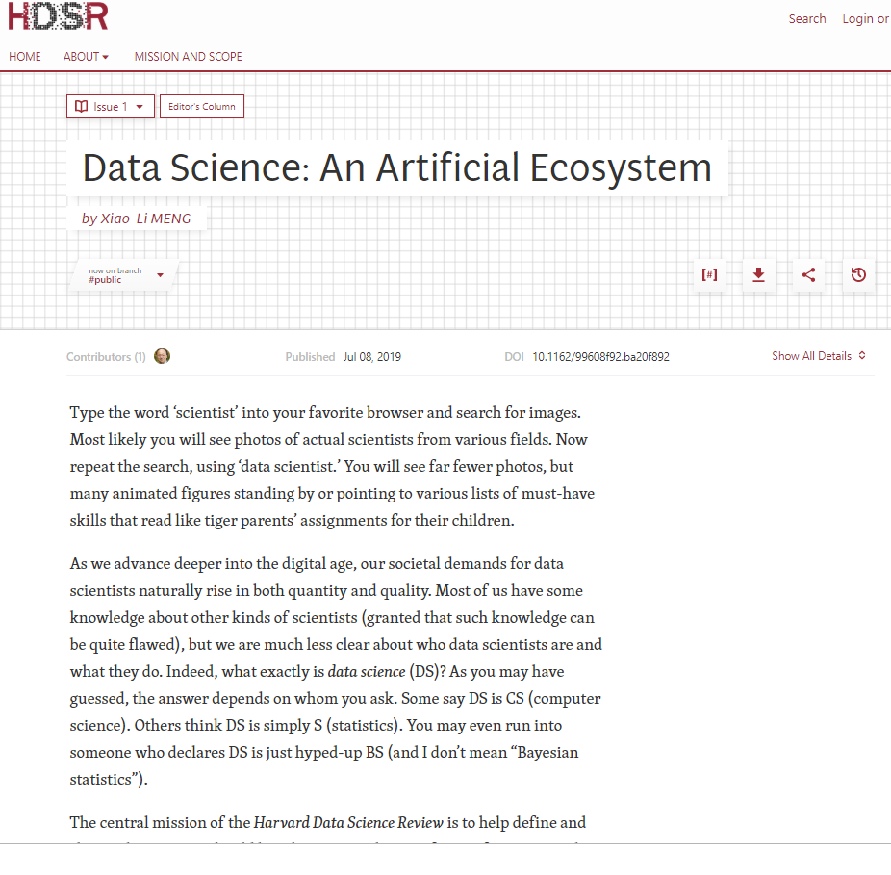

Slide 18
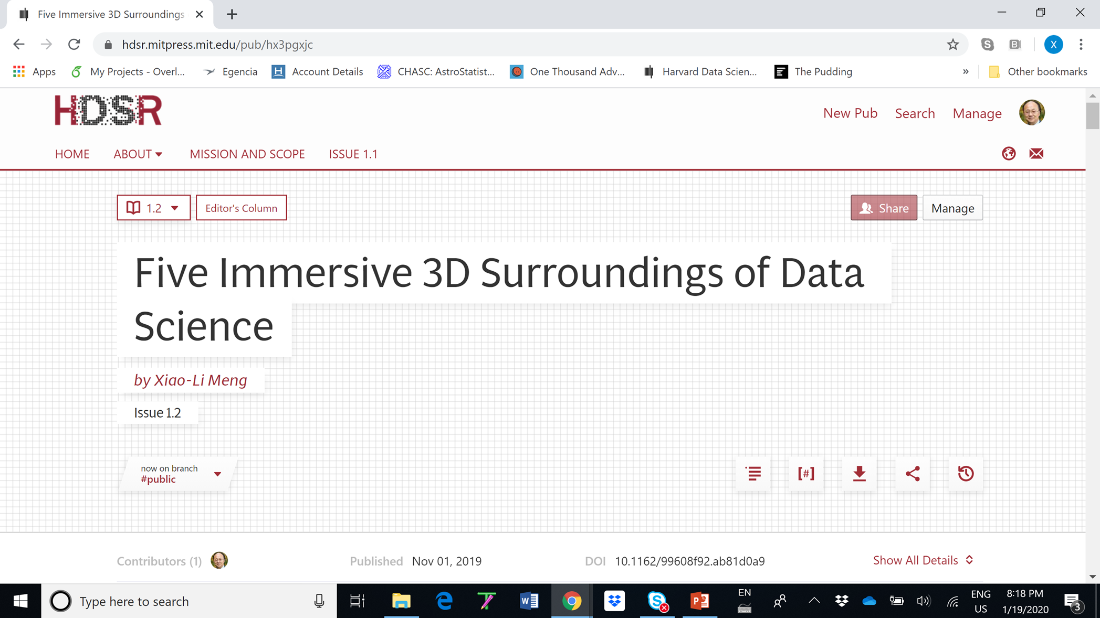

Slide 19
The Five 3-Ds
Academia, Government, and Industry.
Humanities, Social Sciences, and STEM.
Spatial, Temporal, and Structural.
Novice, Apprentice, and Expert.
Philosophical, Analytical, and Practical.

Slide 20
ER signals:
Critical
Vital
Urgent
Hope
Life
…
BUT also
Crisis
Desperation
Overwhelmed
Temporary/Rushed
Sleep deprived
Death
…
Business & Industry
Ethics &
Research
(ER)
Government
& NGO
Academia
& Education

Slide 21
More Confusing Questions:
What is AI?
Does AI=DS?

Slide 22
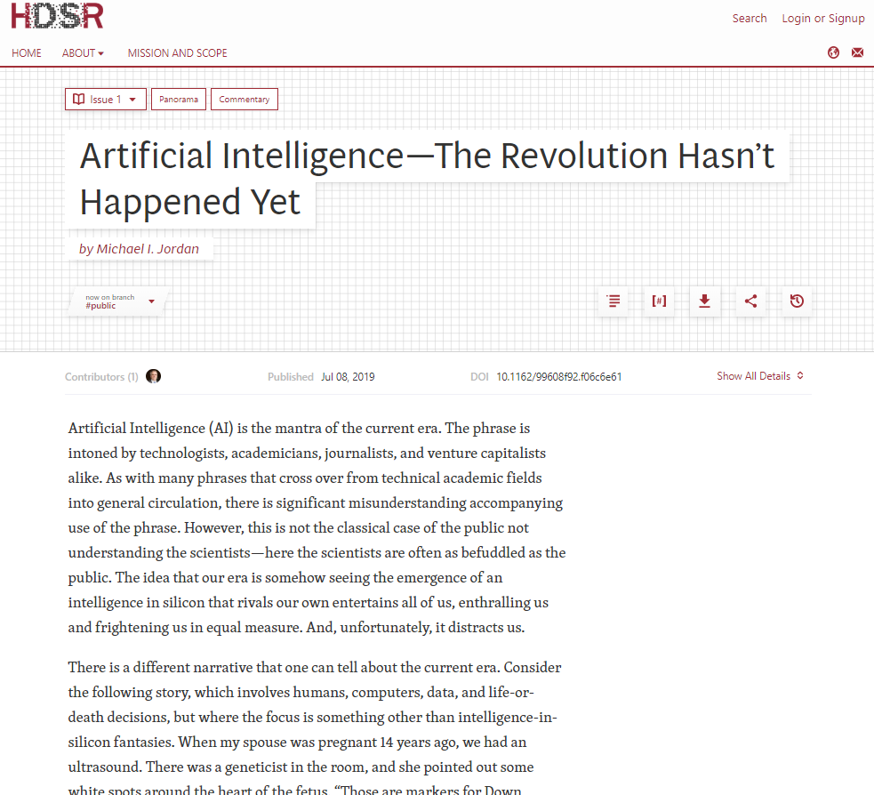


Slide 23
Artificial intelligence—the revolution hasn't happened yet Michael Jordan
Discussions by
Rodney Brooks (MIT)
Emmanuel Candes, John Duchi, and Chiara Sabatti (Stanford University)
Greg Crane (Tufts University and Leipzig University)
David Donoho (Stanford University)
Maria Fasli (University of Essex)
Barbara Grosz (Harvard University)
Andrew Lo (MIT)
Maja Mataric (University of Southern California)
Brendan McCord (US Department of Defense)
Max Welling (University of Amsterdam & Qualcomm Technologies)
Rebecca Willett (University of Chicago)

Slide 24
What is AI? “It depends on what the meaning of the word ‘is’ is.”
AI was about “imitating human intelligence”
AI is ML or anything media perceives as ML/AI
AI should be about (according to Michael Jordan)
Intelligence Augmentation (IA) “Computation and data are used to create services that augment human intelligence and creativity.”
Intelligent Infrastructure (II) “A web of computation, data, and physical entities exists that makes human environments more supportive, interesting, and safe.”
A human-centric engineering discipline

Slide 25
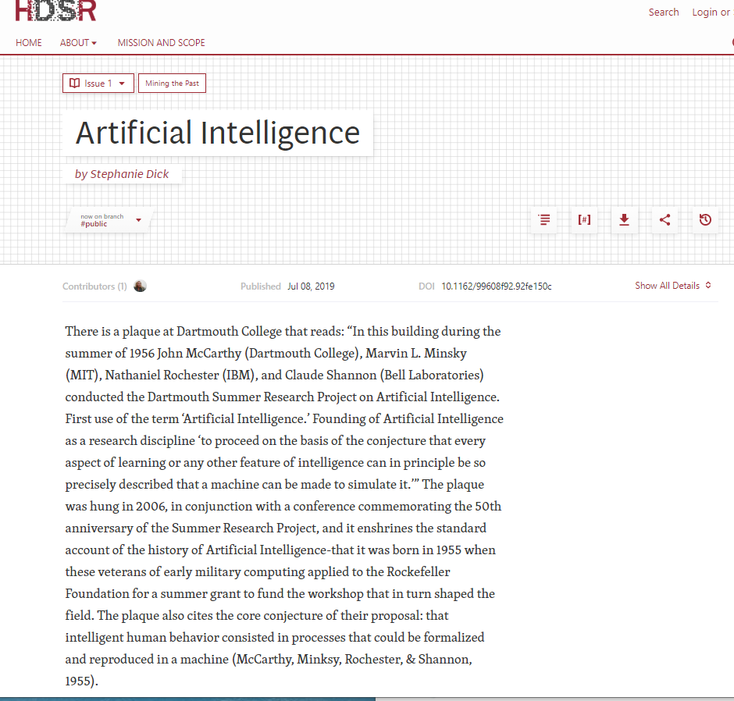
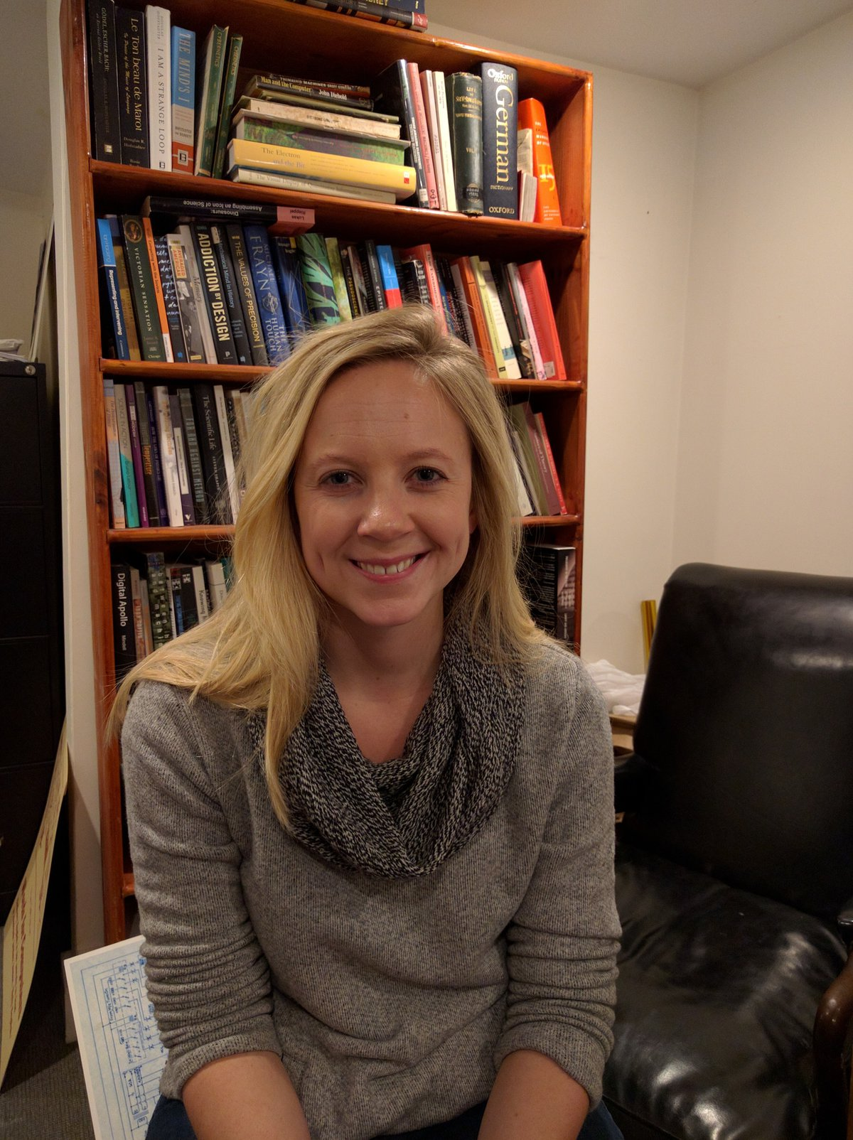

Slide 26
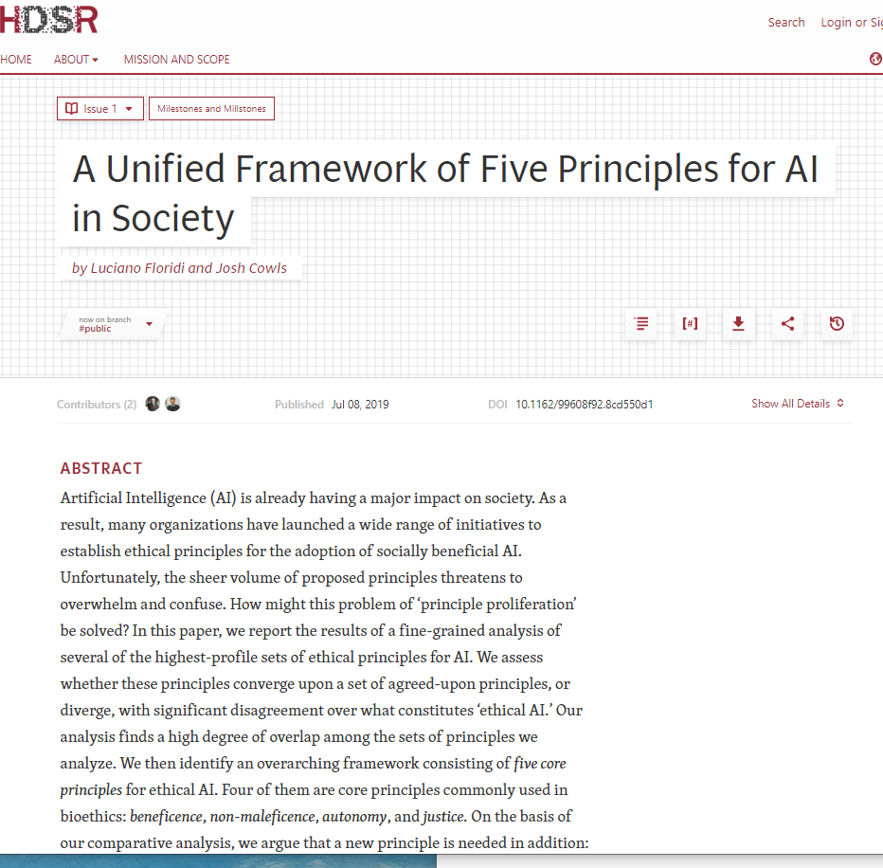
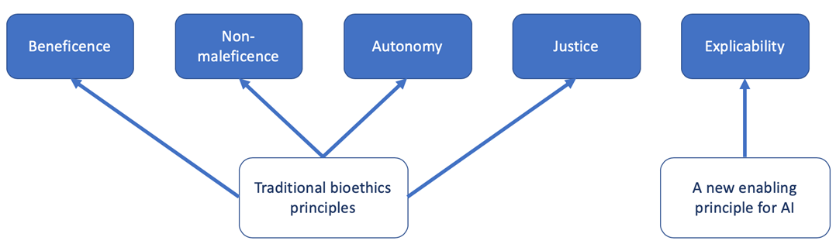


Slide 27
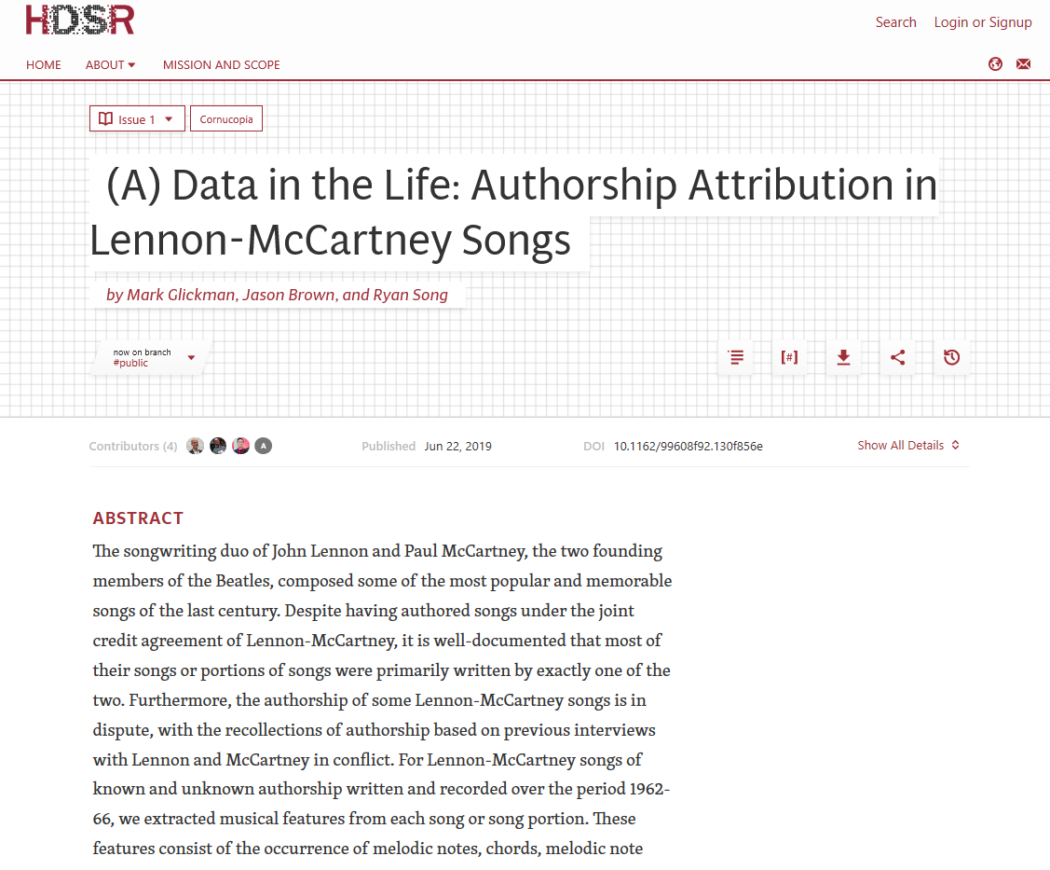
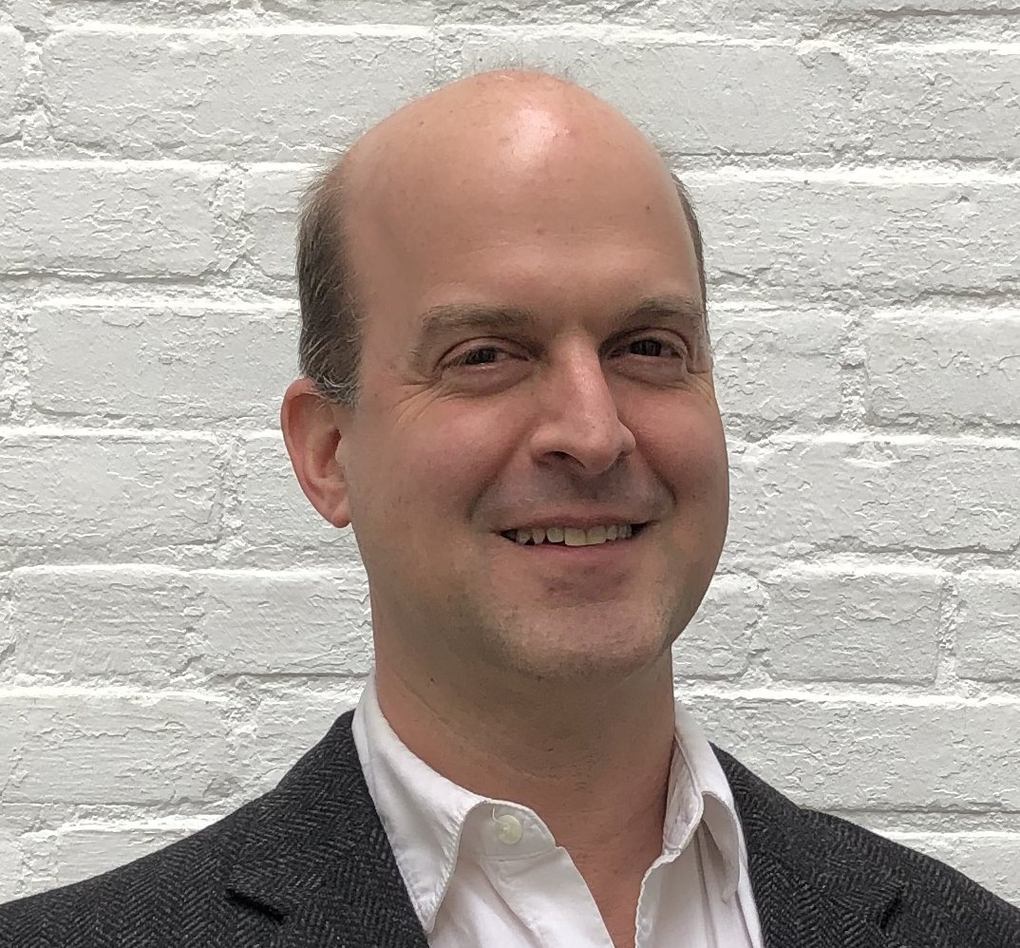

Slide 28
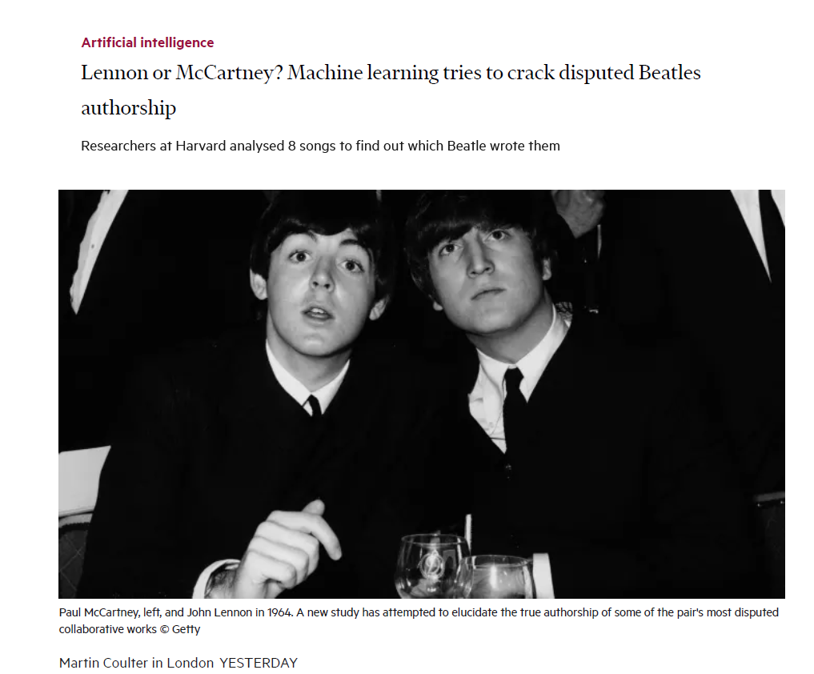

Slide 29

You are a data scientist (if you can handle logistics … )

Slide 30
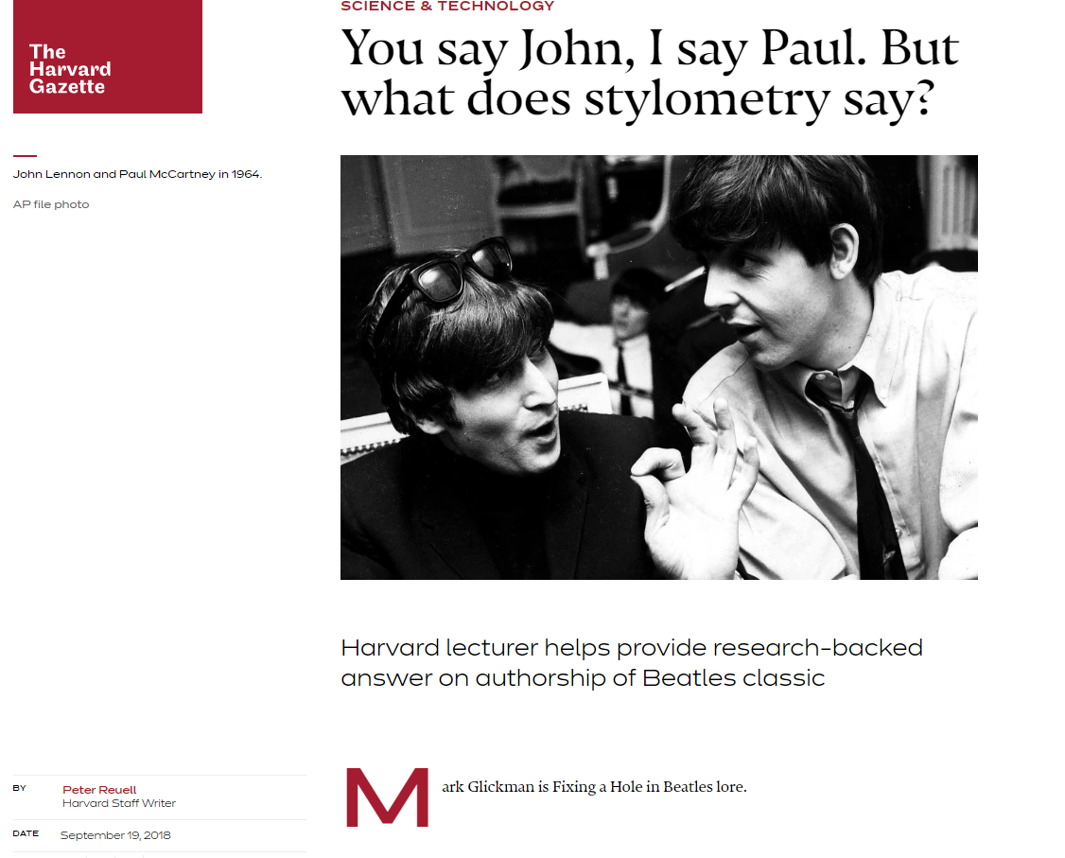

Slide 31
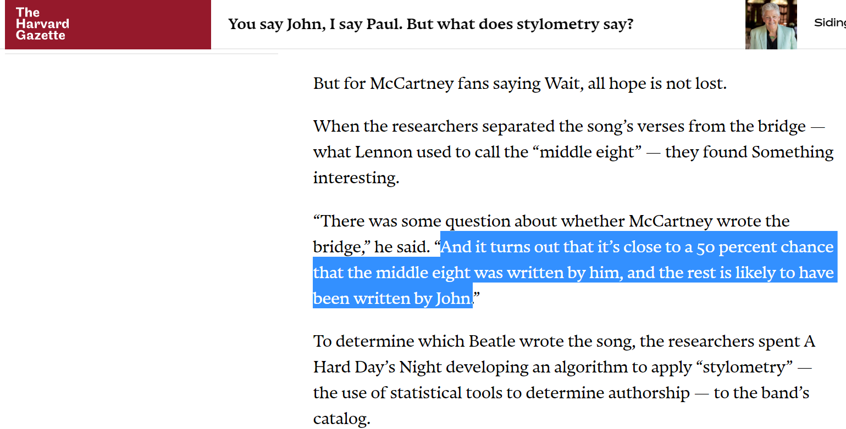
Something odd?

Slide 32

The 3CV approach Draper D (2013). Bayesian model specification: heuristics and examples. Bayesian Theory and Applications (Damien et. Al., Editors) Oxford, 409--431
(1) Partition the data into modeling (M), validation (V) and calibration (C) subsets;
(2) Use M to explore a variety of models until you've found one or more plausible candidates, which you can collect in an ensemble P= {P1,…, Pm};
(3) See how well the models in P predictively validate in V;
(4) If none of them does, iterate (2) and (3) until you do get good validation;
(5) Fit the best model in P (or, better, use Bayesian model averaging with
the entire ensemble P) on the data in (M+V), and report both
(i) inferential conclusions based on this fit,
(ii) the quality of predictive calibration of your model/ensemble on the data in C.
However, if I don’t like what I see from (ii), and hence go back to (2), then
the calibration is no longer valid – I will need 4 CV! In general, we need (N+1) CV in general.

Slide 33
Data Science Well Done …
“The article is outstanding in terms of thoughtful feature construction and rigorous application of statistical methodology. The authors took care to construct reasonable musical features based on domain knowledge (musical theory). They also went to extraordinary lengths to ensure that the model doesn’t overfit the feature set and that the results are reliable. The cascading validation setup (using leave-one-out to tune variable screening and 5fold cross validation for model tuning) was a highlight for me. ….
I thought it was an exemplary demonstration of how data science should be done.”

Slide 34
Everything Data Science & Data Science for Everyone One

